Slide 1
Urinary system
The urinary system consists of two kidneys. A single midline urinary bladder, two ureters which carry the urine from the kidney to the urinary bladder and a single urethra which carries the urine from the bladder to the to the outside of the body.
The kidneys make up the main purification system of the body . They control the composition of the blood by removing the waste products and conserving the useful substances.
The kidneys are the major excretory organ among other excretory organs of the body: skin, liver, lungs and intestine.
Functions of the kidneys
Excretory function
Kidneys filter blood producing large volume of large molecules (proteins, RBCs) are retained in the blood, small molecules and ions enter the filtrate.
Most of filtrate volume is reabsorbed back into the blood.
Metabolic waste, toxic materials and excess ions remain in small volume of filtrate.
Additional waste products are secreted into the filtrate resulting urine formation.

Slide 2
Regulatory function
Regulation of blood volume and pressure by controlling the extracellular fluid volume ( ECF) in the body by producing either a large volume of diluted urine or a small volume of concentrated urine.
Regulation of concentration of solutes in the blood by regulation of concentration of major ions (Na^{+ ,} Cl^{- ,}HCO⁻₃, HPO⁻₄ ) .
Regulation of PH of ECF by secreting variable amounts of H⁺ .
Regulation of the synthesis of RBCs by secreting of erythropoietin hormones.
Vitamin D synthesis therefore regulates Ca⁺² blood level.
Structure of the kidneys
The kidneys are paired of bean shaped organs that lie behind peritoneal lining of the abdominal cavity .
Each kidney is surrounded by a thin capsule to resist stretch and limit the swelling.
The renal artery ,renal vein, renal lymphatic and ureter enter and leave the kidney through a helium on the midline concave surface of the kidney.

Slide 3
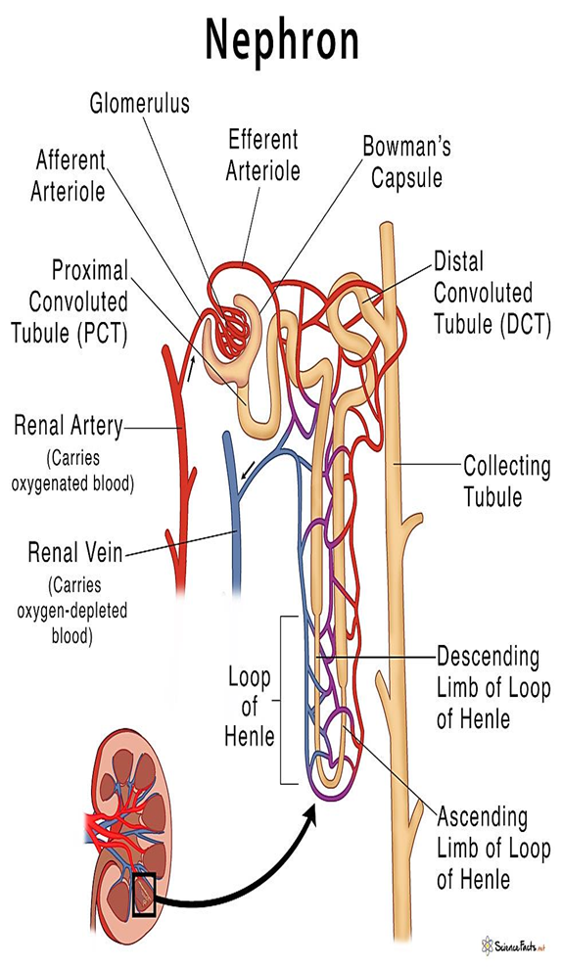
Internal structure of the kidney
There are two distinguished layers inside the longitudinal section of the kidney. The outer layer the cortex and the inner layer the medulla.
The medulla made up of series of cones shaped pyramids which project to the minor calyces.
Minor calyces open into major calyces which open into renal pelvis The renal pelvis leads to the ureter which drains into the bladder.
Structure of the nephron
The functional unit of the kidney is the nephron ( where the blood is filtrated).
Nephron is blind end tubules running from the Bowman's capsule into the renal pelvis There are about one million nephrons in each kidney.
The nephron begins at the glomerulus ( comprises a tuft of glomerular capillaries with the Bowman's capsule).
The capillaries are derived from the afferent arterioles and drain into the efferent arterioles .
The glomerulus and Bowman's capsule form the renal corpuscle.
The materials leave the blood in the glomerulus and the Bowman's capsule through the filtration membrane .
Fluid from Bowman's capsule flows into the coiled segment (proximal convoluted tubule) , then into loop of Henle, down into the medulla.

Slide 4
There are two types of nephrons:
Cortical nephrons:
The glomeruli are in the two thirds of the cortex (85%).
Short loop of Henle, that dips into the outer medulla ( further from corticomedullary junction).
Efferent arteriole supplies peritubular capillaries
Juxtramedullary nephrons
Glomeruli are in the inner cortex.
long loop of Henle extend deeply into the medulla( closer to the corticomedullary junction).
Efferent arterioles supplies vasa recta.
Proximal convoluted tubule is about 14mm long, 60 µm in diameter. It is composed of simple cuboidal epithelial cells, made up the wall.
Loop of Henle are continuous of proximal convoluted tubule, each loop has two limbs: descending and ascending .
The ascending limb of loop of Henle leads into a second coil section: the distal convoluted tubule.
Distal convoluted tubule begins at a special structure: the juxtraglomerular apparatus.
Collecting duct : the cells of the collecting duct have some microvilli and numerous mitochondria.

Slide 5
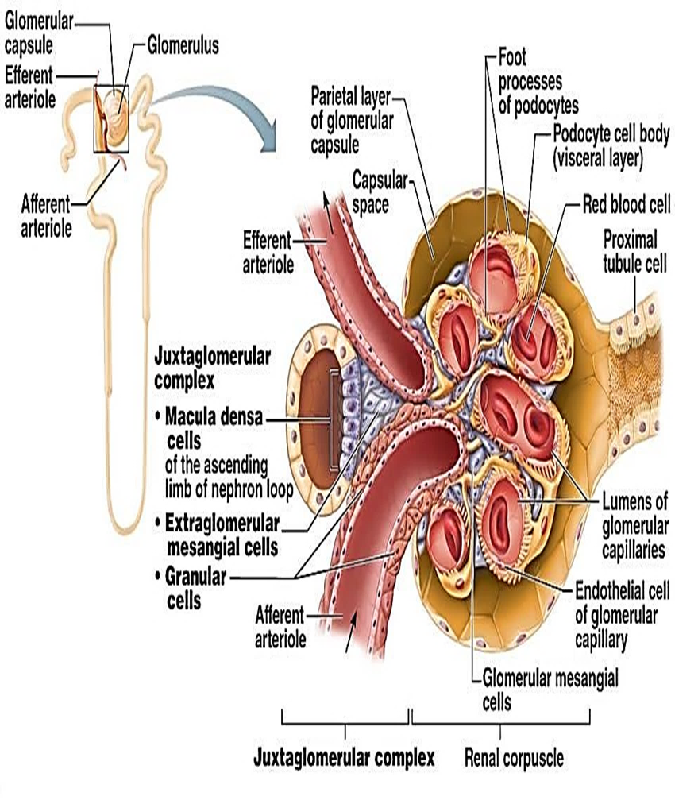
Juxtaglomerular apparatus:
The JGA includes two cell populations that play important roles in regulation the rate of filtrate formation and systemic blood pressure.
In the arteriole walls are granular cells also called (JG) cells which are smooth muscle cells with secretory granules containing renin . Granular cells act as mechanoreceptors to sense the blood pressure.
The macula densa is a group of tall ,closely packed cells of the distal convoluted tubule that lies adjacent to the granular cells. The macula densa cells are chemoreceptors that respond to changes in the NaCl content of the filtrate.
A third cells is also part of the JGA called the extra glomerular mesangial cells . These cells are interconnected by gap junctions and may pass signals between macula densa and granular cells.

Slide 6
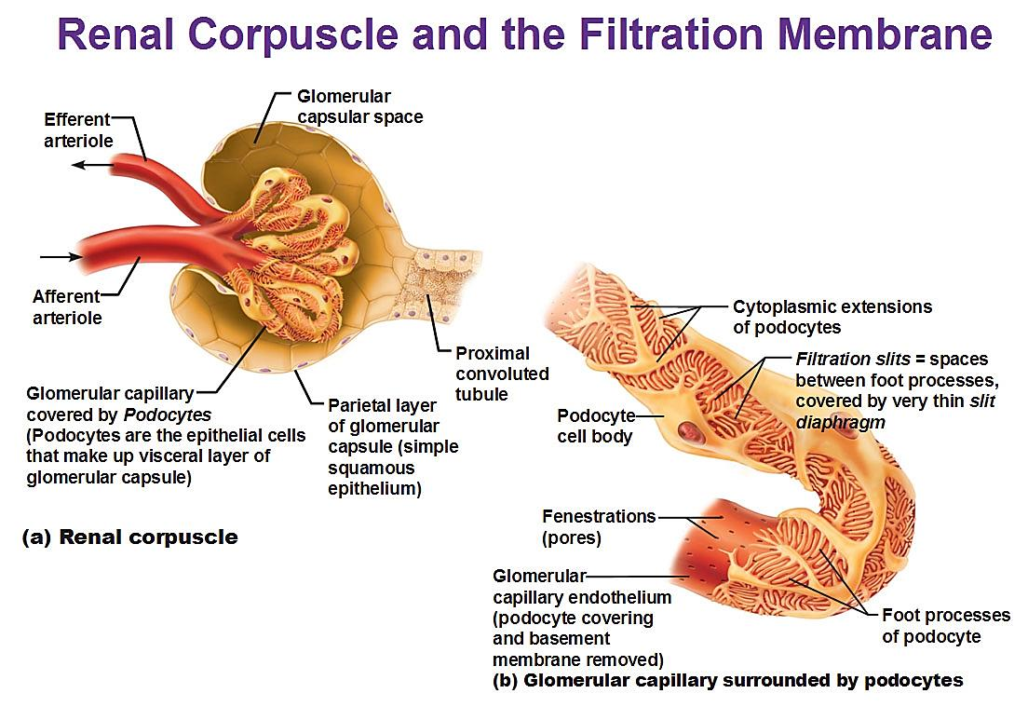
Structure of the glomerulus (filtration membrane)
Glomerulus is composed of fenestrated capillaries.
The filtrated fluid passes from the capillaries into the Bowman's capsule through the filtration membrane consists of :
Fenestrated glomerular capillary endothelium.
Basement membrane.
Podocytes processes

Slide 7
Renal blood flow
The renal artery enters the kidneys at the hilum.
The renal artery branches to form interlobar arteries, which radiate out towards the cortex.
Interlobar arteries diverge near the base of the pyramid to form arcuate.
Interlobar arteries give rise to the afferent arterioles that supply the glomerular capillaries.
Efferent arterioles arise from the glomerular capillaries to carry the blood away from the glomeruli.
When the efferent arterioles exists the glomerulus, it give rise to plexus of capillaries, peritubular capillaries around the proximal and distal tubules.
Vasa recta is specialized part of the peritubular capillaries course into the medulla along the loop of Henle of the juxtamedullary nephrons, then back toward the cortex.
Veins form from peritubular capillaries are : interlobular veins to arcuate vein to interlobar vein to renal vein.
Renal nerve supply
The kidney has rich sympathetic noradrenergic innervations which supply renal artery and its branches, juxtaglomerular apparatus and renal tubules.

Slide 8
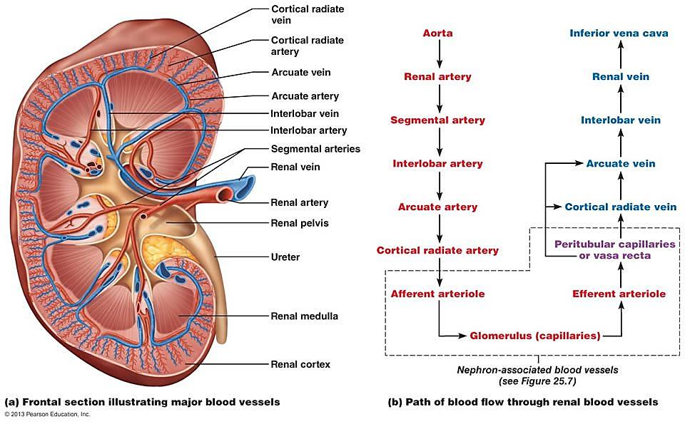
Blood supply through the kidney

Slide 9
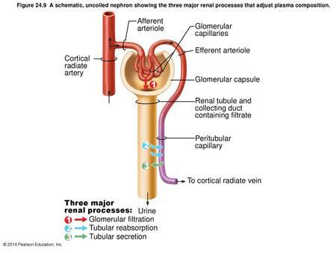
Urine formation
Three major processes are essential for urine formation: filtration, tubular reabsorption and tubular secretion
Filtration
Filtration is the movement of water and small solutes from blood flowing through the glomerulus across the filtration membrane as a result of pressure differences into the Bowman's capsule forming the filtrate .
Most substances in plasma ( except for proteins) are freely filtrated, so their concentrations in the glomerular filtrate in the Bowman's capsule are the same in the plasma.
Glomerular blood flow
The part of the total cardiac output that passes through the kidney is called renal fraction .
The normal cardiac output is 5600ml\min , which the renal fraction is 1200ml\min which represents 21% and varies from 12-30%.
Glomerular filtrate
Glomerular filtrate is the fluid filtrated through the glomerular membrane into Bowman's capsule.
Filtration membrane is composed of three layer each of these layer is several hundred times as permeable as the capillary .

Slide 10
The reasons for the high selectivity of the glomerular membrane are:
Size of the pores in the glomerular membrane is large enough to pass molecules with diameter 3 nm.
Electrical charges of the molecules. The pores are lined by glycosylated proteins which have strong negative electrical charges.
Glomerular filtrate has the same components of the plasma except it has no significant amount of proteins.
The glomerular filtration rate (GFR)
The glomerular filtration rate (GFR) is the quantity of glomerular filtrate form each minute in all nephrons of both kidneys. It is 125ml\min in normal person.
Glomerular filtrate is reabsorbed in the tubules, while remaining is passing into urine.
Normal plasma flow through the kidney is 650ml\min and GFR of both kidneys is 125ml\min, so the average filtration fraction is 19%

Slide 11
Factors that affect the GFR
The factors that determine the filtration pressure (glomerular pressure, plasma colloid osmotic pressure and Bowman's capsule pressure ) will determine the GFR.
The conditions that affect these pressures and therefore affect the GFR are:
Renal blood flow: an increase in the rate of blood flow through the nephrons increases the GFR by increasing the glomerular pressure which enhances the filtration process.
Afferent arteriolar constriction decreases the rate of blood flow into the glomerular and also decreases the glomerular pressure causing a decrease in the filtration rate.
Efferent arterioles constriction causes an increase in the resistance to outflow from the glomeruli. This increases the glomerular pressure and increase in efferent resistance causes slight increase in the GFR.
Sympathetic stimulation of the kidneys causes the afferent arterioles to constrict, thereby decreasing the GFR .
With strong sympathetic stimulation, glomerular blood flow and glomerular pressure are reduced so that glomerular filtration decreases to only a few percent of normal and the urinary output can fall to zero for as long as 5 to 10 minutes.

Slide 12
Arterial pressure
When the arterial pressure rises , afferent arteriolar constriction occurs automatically. This prevents a significant rise in glomerular pressure despite the rise in the arterial pressure. Therefore, the GFR increases only few percent even when the mean arterial pressure rises to 150 mmHg. This phenomenon is called auto regulation.
Glomerular nephritis results from inflammation of the filtration membrane within the renal corpuscle. The inflammation leads to increased membrane permeability and accumulation of WBCs in the area resulting in high concentration of plasma proteins that enter the filtrate along with WBCs. glomerular nephritis may be acute when occurs within 1-3 weeks after bacterial infection, or chronic which is long. The filtration membrane becomes thick and replaced by connective tissues.

